Slide 1
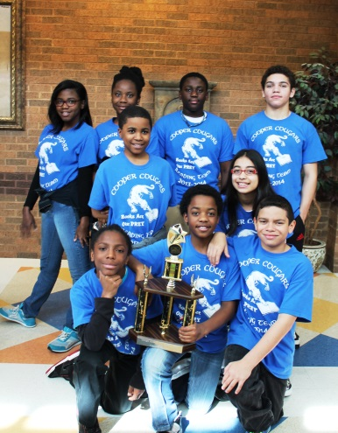
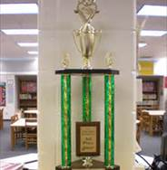
Helen Ruffin Reading Bowl
Books for
2015-2016

Slide 2
After moving with her parents and grandmother from the mountains of North Carolina to upstate New York, 10-year-old Prairie Evers is adjusting to life on the farm her mother inherited. When her grandmother decides to move back home, Prairie is heartbroken. Not only has Grammy been her teacher all her young life, but she is also her best friend. Things get even worse when her mother takes a job and Prairie must go to school for the first time in her life. She dislikes being in a classroom from the very beginning. She doesn't like the bus, the noise, and the chaos of being surrounded by so many other children. Prairie would much rather be spending her days with the chickens she is raising on the farm. Then she meets Ivy Blake, her first true friend. When she learns that Ivy has been harboring a dark secret and has a terrible home life, Prairie is determined to help. The Evers invite the quiet girl into their home, and Prairie discovers that sharing her family isn't as easy as she thought it would be

Slide 3
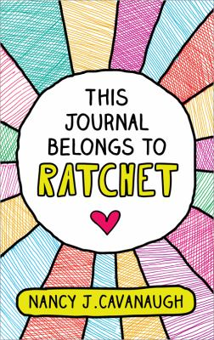
Ten-year-old Ratchet records her observations, complaints ("Everything in my life is old and recycled"), worries, and goals ("To be a girl who fits in-hopefully one with a friend") in a series of writing exercises for her language arts "class" (she's homeschooled by her single father) in Cavanaugh's debut novel. But fitting in is difficult for a girl nicknamed after a mechanic's tool, who doesn't have a mother, doesn't attend a "real" school, and spends her days helping her "crazy environmentalist" father fix cars. Worse, her father's outspoken political views have won him the wrong kind of publicity around town, and his battle to save Moss Tree Park from becoming a strip mall looks like a lost cause. Ratchet's journal-written on lined paper and filled with a medley of lists, poems, stories, essays, and doodles-offers an enticing blend of strong social views, family secrets, and deeply felt emotions.

Slide 4
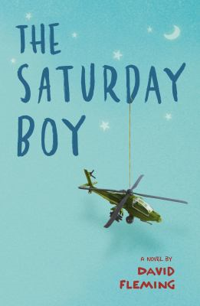
If there's one thing I've learned from comic books, it's that everybody has a weakness--something that can totally ruin their day without fail. For the Wolfman it's a silver bullet. For Superman it's Kryptonite. For me it was a letter. With one letter, my dad was sent back to Afghanistan to fly Apache helicopters for the U.S. army. Now all I have are his letters. Ninety-one of them to be exact. I keep them in his old plastic lunchbox--the one with the cool black car on it that says Knight Rider underneath. Apart from my comic books, Dad's letters are the only things I read more than once. I know which ones to read when I'm down and need a pick-me-up. I know which ones will make me feel like I can conquer the world. I also know exactly where to go when I forget Mom's birthday. No matter what, each letter always says exactly what I need to hear. But what I want to hear the most is that my dad is coming home.

Slide 5
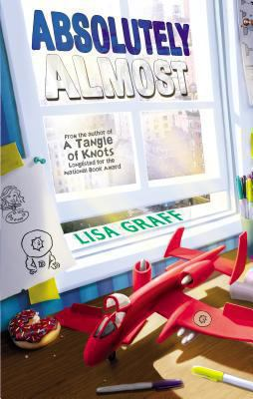
Albie, an only child living in New York City, has learning difficulties. No matter how hard he tries to give the correct change to the takeout delivery guy, or get all his spelling words correct, he inevitably fails to get it right. When readers meet the fifth-grader, he's just left his fancy private school and is about to be the new kid at public school. His dad is mostly absent and forgetful, except when demanding that Albie try harder. His mom tells him that Dav Pilkey's "Captain Underpants" (Scholastic) is for babies, and gives him Esther Forbes's Johnny Tremain instead. His exacting Korean grandfather predicts that he will end up in a ditch. At school, despite some sympathetic teachers, he is bullied and teased. His only friend is Betsy, reserved and bullied herself. Things begin to change when Albie gets a new babysitter. Calista is an artist and definitely unusual: she makes a cover for Albie's Captain Underpants that says "Johnny Tremain." She takes him for donuts and to art exhibits and, most importantly, she likes him for who he is.

Slide 6
A gripping novel based on the astonishing true story of a boy who survived ten concentration camps. Based on the true story by Ruth and Jack Gruener. 10 concentration camps. 10 different places where you are starved, tortured, and worked mercilessly. It's something no one could imagine surviving. But it is what Yanek Gruener has to face. As a Jewish boy in 1930s Poland, Yanek is at the mercy of the Nazis who have taken over. Everything he has, and everyone he loves, have been snatched brutally from him. And then Yanek himself is taken prisoner -- his arm tattooed with the words PRISONER B-3087. He is forced from one nightmarish concentration camp to another, as World War II rages all around him. He encounters evil he could have never imagined, but also sees surprising glimpses of hope amid the horror. He just barely escapes death, only to confront it again seconds later. Can Yanek make it through the terror without losing his hope, his will -- and, most of all, his sense of who he really is inside?

Slide 7
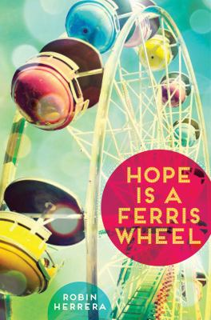
Ten-year-old Star Mackie lives in a trailer park with her flaky mom and her melancholy older sister, Winter, whom Star idolizes. Moving to a new town has made it difficult for Star to make friends, when her classmates tease her because of where she lives and because of her layered blue hair. But when Star starts a poetry club, she develops a love of Emily Dickinson and, through Dickinson's poetry, learns some important lessons about herself and comes to terms with her hopes for the future. With an unforgettable voice with a lot of heart, Hope Is a Ferris Wheel is the story of a young girl who learns to accept her family and herself while trying to make sense of the world around her

Slide 8
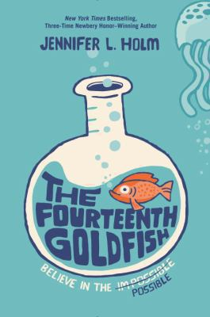
Galileo. Newton. Salk. Oppenheimer. Science can change the world . . . but can it go too far? Eleven-year-old Ellie has never liked change. She misses fifth grade. She misses her old best friend. She even misses her dearly departed goldfish. Then one day a strange boy shows up. He's bossy. He's cranky. And weirdly enough . . . he looks a lot like Ellie's grandfather, a scientist who's always been slightly obsessed with immortality. Could this pimply boy really be Grandpa Melvin? Has he finally found the secret to eternal youth? With a lighthearted touch and plenty of humor, Jennifer Holm celebrates the wonder of science and explores fascinating questions about life and death, family and friendship, immortality . . . and possibility.

Slide 9
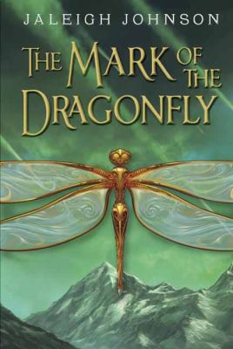
Piper has never seen the Mark of the Dragonfly until she finds the girl amid the wreckage of a caravan in the Meteor Fields. The girl doesn't remember a thing about her life, but the intricate tattoo on her arm is proof that she's from the Dragonfly Territories and that she's protected by the king. Which means a reward for Piper if she can get the girl home. The one sure way to the Territories is the 401, a great old beauty of a train. But a ticket costs more coin than Piper could make in a year. And stowing away is a difficult prospect--everyone knows that getting past the peculiar green-eyed boy who stands guard is nearly impossible. Life for Piper just turned dangerous. A little bit magical. And very exciting, if she can manage to survive the journey

Slide 10
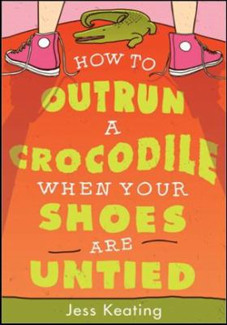
Ana Wright's social life is now officially on the endangered list: she lives in a zoo (umm, elephant droppings!?), her best friend lives on the other side of the world, and the Sneerers are making junior high miserable. All Ana wants is to fade into the background. Yeah, that's not going to happen.
Creature File for Ana Wright
Species Name: Anaphyta Normalis. Kingdom: The Zoo, Junior High.
Phylum: Girls Whose Best Friend Just Moved To New Zealand; Girls Who Are Forced To Live In A Zoo With their Weirdo Parents And Twin Brother.
Weight: Classified.
Feeds On: Daydreams about Zackardia Perfecticus and wish cupcakes.
Life Span: Soon to become extinct due to social awkwardness.

Slide 11
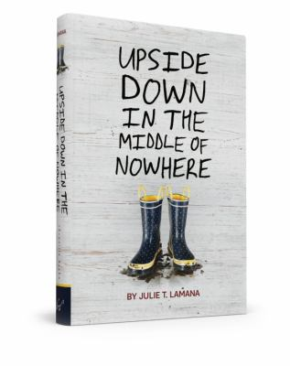
Armani Curtis can think about only one thing: her tenth birthday. All her friends are coming to her party, her mama is making a big cake, and she has a good feeling about a certain wrapped box. Turning ten is a big deal to Armani. It means she's older, wiser, more responsible. But when Hurricane Katrina hits the Lower Nines of New Orleans, Armani realizes that being ten means being brave, watching loved ones die, and mustering all her strength to help her family weather the storm.

Slide 12
Present-day East Turkestan is the setting for this compelling novel of a Uyghur girl's struggle to hold on to hope in the midst of poverty and oppression. Mehrigul, 14, has been forced by her embittered father to leave school and work on their farm, filling the role of her older brother, who has left the family to seek a better life. She must assume the responsibilities of her depressed and powerless mother; show respect for her father, who drinks and gambles away their meager earnings; and face the growing threat that she will be sent to work in a factory in southern China. On market day, an American woman offers a large sum of money to purchase a grapevine basket Mehrigul has made and asks her to make more, and the teen recognizes that her life could change. With the help and emotional support of her beloved grandfather and the drive to assure that her younger sister stays in school, Mehrigul begins making the baskets, slowly discovering her own talent and creativity, only to be thwarted by seemingly insurmountable obstacles.

Slide 13
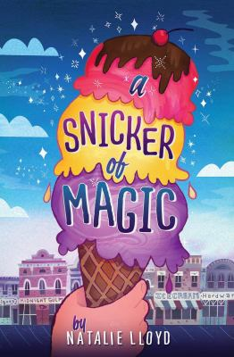
Midnight Gulch used to be a magical place, a town where people could sing up thunderstorms and dance up sunflowers. But that was long ago, before a curse drove the magic away. Twelve-year-old Felicity knows all about things like that; her nomadic mother is cursed with a wandering heart. But when she arrives in Midnight Gulch, Felicity thinks her luck's about to change. A "word collector," Felicity sees words everywhere---shining above strangers, tucked into church eves, and tangled up her dog's floppy ears---but Midnight Gulch is the first place she's ever seen the word "home." And then there's Jonah, a mysterious, spiky-haired do-gooder who shimmers with words Felicity's never seen before, words that make Felicity's heart beat a little faster. Felicity wants to stay in Midnight Gulch more than anything, but first, she'll need to figure out how to bring back the magic, breaking the spell that's been cast over the town . . . and her mother's broken heart.

Slide 14
When Lucy's family moves to an old house on a lake, Lucy tries to see her new home through her camera's lens, as her father has taught her -- he's a famous photographer, away on a shoot. Will her photos ever meet his high standards? When she discovers that he's judging a photo contest, Lucy decides to enter anonymously. She wants to find out if her eye for photography is really special -- or only good enough. As she seeks out subjects for her photos, Lucy gets to know Nate, the boy next door. But slowly the camera reveals what Nate doesn't want to see: his grandmother's memory is slipping away, and with it much of what he cherishes about his summers on the lake. This summer, Nate will learn about the power of art to show truth. And Lucy will learn how beauty can change lives . . . including her own.

Slide 15
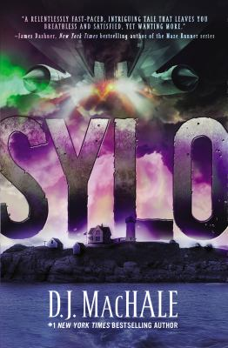
THEY CAME FROM THE SKY parachuting out of military helicopters to invade Tucker Pierce's idyllic hometown on Pemberwick Island, Maine. They call themselves SYLO and they are a secret branch of the U.S. Navy. SYLO's commander, Captain Granger, informs Pemberwick residents that the island has been hit by a lethal virus and must be quarantined. Now Pemberwick is cut off from the outside world. Tucker believes there's more to SYLO's story. He was on the sidelines when the high school running back dropped dead with no warning. He saw the bizarre midnight explosion over the ocean, and the mysterious singing aircraft that travel like shadows through the night sky. He tasted the Ruby--and experienced the powers it gave him--for himself. What all this means, SYLO isn't saying. Only Tucker holds the clues that can solve this deadly mystery. LOOK TO THE SKY because Pemberwick is only the first stop.

Slide 16
This has got to be the Worst Christmas EVER! declares 11-year-old Sam Brattle. He has a swelling police record and no respect for anyone or anything. His mother left before his heart transplant at age 3 1/2. His friends are older delinquents. His father's business is failing. On top of that, Nickel Bay Nick the secret benefactor who leaves 45 $100 bills around his deteriorating town before Christmas has disappeared. When Sam damages part of Herbert Wells' house, he is blackmailed into service to help cover the repairs. The job isn't what Sam expects because Herbert, whose leg is broken, reveals he is Nickel Bay Nick. To become Herbert's operative before it's too late, Sam has no choice but to listen, obey orders, and accept responsibility. The often-thankless execution of the distributions changes his perspective about friends, family, and community

Slide 17
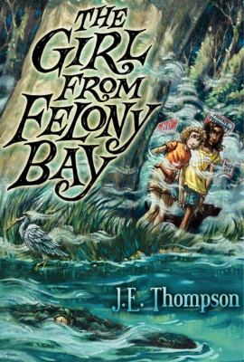
I'm not going to lie to you: the last year has been rougher than alligator hide for me and my dad. You see, he's in the hospital in a coma since his accident a year back, wherein he was framed for a terrible crime he didn't commit. Our home, Reward Plantation, had to be sold to pay off his debt to society, so I'm stuck living with my uncle Charlie, who, even in the few hours a day when he's sober, ain't exactly your ideal parental role model. And I managed to run afoul of Jimmy Simmons, the meanest kid in the sixth grade, and on the last day of school no less. But things just got a bit more interesting. Turns out the new family that moved into Reward Plantation has a daughter named Bee, who is the same age as I am. And she's just as curious about all the No Trespassing signs and holes being dug out by Felony Bay, in the corner of what used to be my home. Seems like someone's been poking around a mystery that dates all the way back to the Civil War--and it just might be the same someone who framed my dad. I'm Abbey, by the way. Abbey Force. And if it takes all summer, I'm going to find out what's happening out on Felony Bay, and maybe even clear my dad's name.

Slide 18
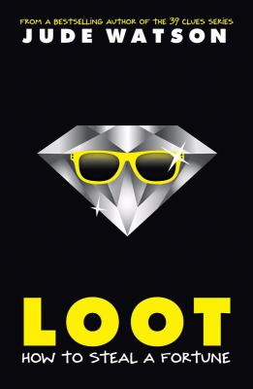
On a foggy night in Amsterdam, a man falls from a rooftop to the wet pavement below. It's Alfie McQuinn, the notorious cat burglar, and he's dying. As sirens wail in the distance, Alfie manages to get out two last words to his young son, March: "Find jewels." But March learns that his father is not talking about a stash of loot. He's talking about Jules, the twin sister March never knew he had. No sooner than the two find each other, they're picked up by the police and sent to the world's worst orphanage. It's not prison, but it feels like it. March and Jules have no intention of staying put. They know their father's business inside and out, and they're tired of being pushed around. Just one good heist, and they'll live the life of riches and freedom most kids only dream about. Watch out! There are wild kids on the loose and a crime spree coming . .

Slide 19
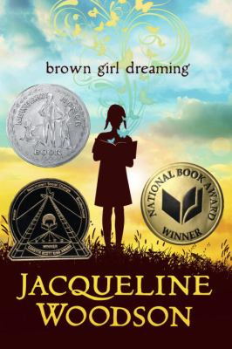
"I am born in Ohio but the stories of South Carolina already run like rivers through my veins" writes Woodson as she begins her mesmerizing journey through her early years. She was born in Columbus, Ohio in 1963, "as the South explodes" into a war for civil rights, and was raised in South Carolina and then New York. Her perspective on the volatile era in which she grew up is thoughtfully expressed in powerfully effective verse, (Martin Luther King is ready to march on Washington; Malcom X speaks about revolution; Rosa Parks refuses to give up her seat only seven years earlier and three years have passed since Ruby Bridges walks into an all-white school). She experienced firsthand the acute differences in how the "colored" were treated in the North and South. "After the night falls and it is safe for brown people to leave the South without getting stopped and sometimes beaten and always questioned; we board the Greyhound bus bound for Ohio." She related her difficulties with reading as a child and living in the shadow of her brilliant older sister, she never abandoned her dream of becoming a writer

Slide 20
The men in Jack's family have always worked the mines. The 13-year-old has already lost his grandfather and his uncle to cave-ins and explosions, and he lives in fear of a similar accident taking the life of his father. In the mid-1980s, the Southern Appalachian Coppertown is a barren, desolate place, long stripped of trees and grass by a century of mining. Jack doesn't know how to tell his family that he has no desire to follow in his father's footsteps, and he dreams of green trees rather than the moonlike landscape of his Tennessee town. When many of the workers are laid off, the remaining miners organize a strike, thinking that the owners will remedy their unfair actions with better wages and safety conditions. The strike comes at the beginning of the holidays, resulting in a Christmas celebration that is sparser than usual but more meaningful as the community draws together. As the shutdown continues into the spring, Jack notices small signs of life returning to his toxically ravaged town-frog eggs in a shallow pool, a few weeds. He helps the growth along, starting a vegetable garden with his mom and planting a tree in his yard. The company eventually announces that it is closing the mine down for good. What could be a hopeless situation is made tolerable as the families come together to find other work opportunities and enjoy the strange sensation of seeing bugs and birds again. Historic photographs and an author's note round out a tender story of families and friendships against the backdrop of harsh economic conditions.

Slide 21
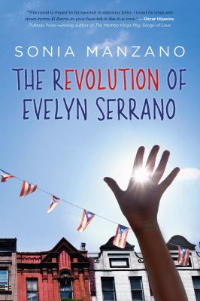
One of America's most influential Hispanics -- 'Maria' on Sesame Street -- presents a powerful novel set in New York's El Barrio in 1969 There are two secrets Evelyn Serrano is keeping from her Mami and Papo? her true feelings about growing up in her Spanish Harlem neighborhood, and her attitude about Abuela, her sassy grandmother who's come from Puerto Rico to live with them. Then, like an urgent ticking clock, events erupt that change everything. The Young Lords, a Puerto Rican activist group, dump garbage in the street and set it on fire, igniting a powerful protest. When Abuela steps in to take charge, Evelyn is thrust into the action. Tempers flare, loyalties are tested. Through it all, Evelyn learns important truths about her Latino heritage and the history makers who shaped a nation. Infused with actual news accounts from the time period, Sonia Manzano has crafted a gripping work of fiction based on her own life growing up during a fiery, unforgettable time in America, when young Latinos took control of their destinies

